Slide 1
Approximating Chess Evaluation Functions with Deep Learning
CMPE 401 Final Project Presentation, Syed Aamir AHmed

Slide 2
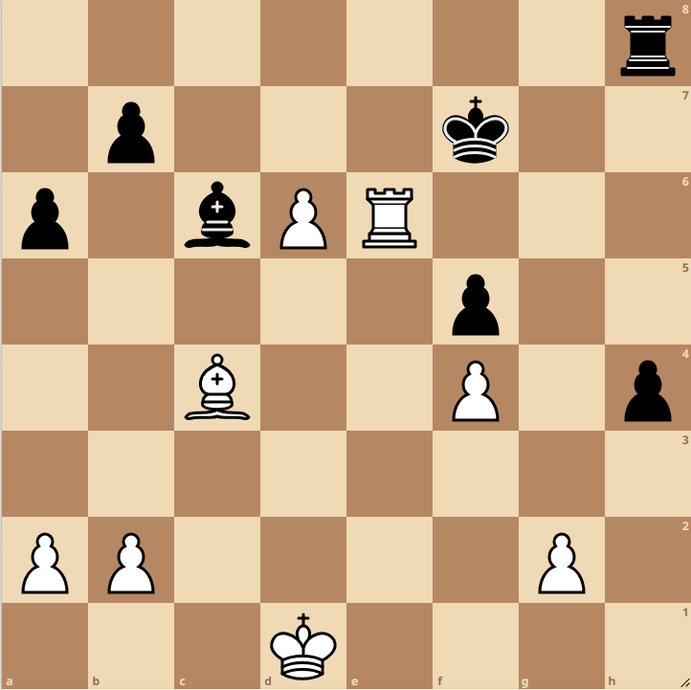

Introduction
Chess is a complex game of perfect information. Traditional engines use search and evaluation functions; this project uses supervised learning on board states.
Positions are represented using Forsyth-Edwards Notation (FEN), a standard text format describing piece placement, side to move, castling rights, etc., which is then converted into numerical input for the models.

Slide 3
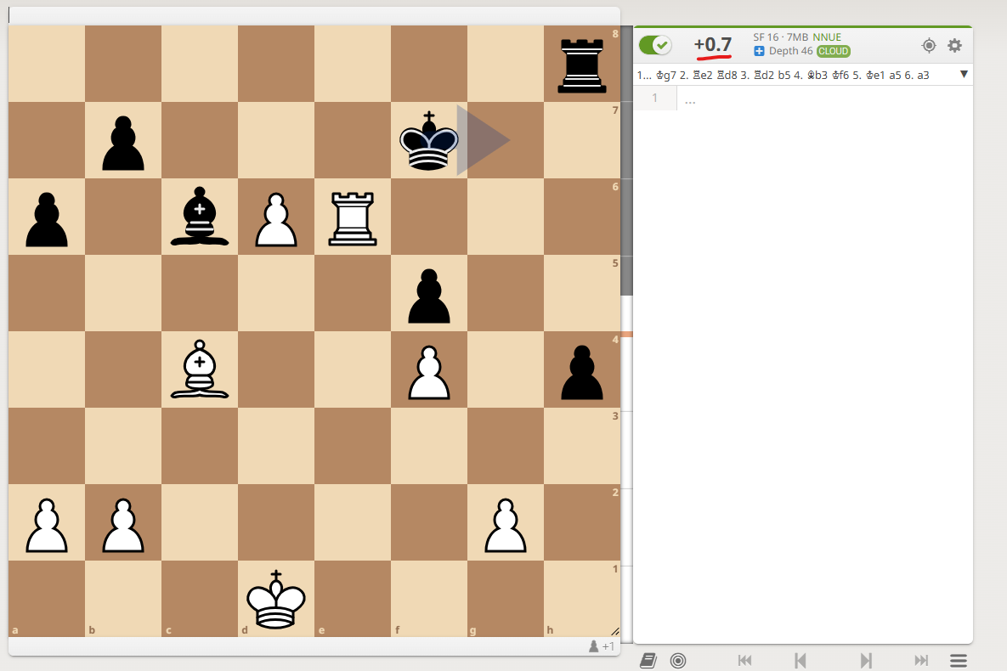
Can Neural Nets Evaluate Chess Positions Like an Engine?
The core problem is determining if end-to-end deep learning models can accurately predict Stockfish's evaluation (ESF​) solely from a board state (S).
Key questions involve comparing the accuracy (MAE) and efficiency (training steps till convergence) and assessing if multi-task learning (predicting win probability along with evaluation) improves performance.
MAE = mean absolute error. Stockfish evals were scaled down by 10, to be in the range -1 to 1, so MAE of 0.1 implies an error of 1 pawn in terms of Stockfish rating.

Slide 4
Scope of the Project
This project investigates using deep learning (CNN, Transformer, MLP) to approximate Stockfish's chess evaluation function directly from board positions, avoiding traditional search or extensive self-play like AlphaZero.
The goal is to compare these architectures on accuracy, training time, and inference speed to find the most effective model for capturing the nuanced evaluation of chess positions.

Slide 5
Data and Preparation
A dataset of ~60 million unique positions was curated from the Lichess database (>200 million positions), each labeled with a Stockfish evaluation.
FEN strings were preprocessed differently for each architecture: token sequences for the Transformer, and 17-channel 8x8 feature maps (piece positions, castling, side-to-move) for CNN and MLP. A binary win/loss label was also derived.

Slide 6
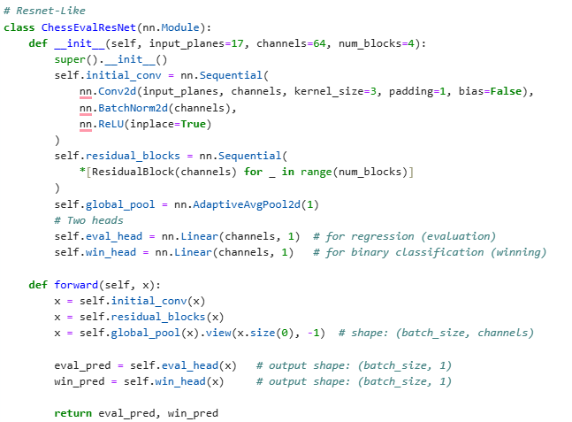
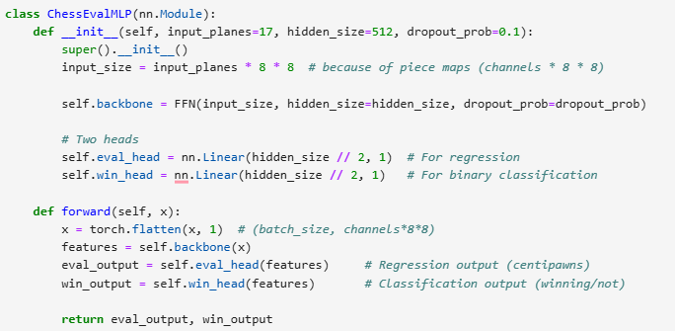
Model Architectures
CNN (ResNet-like): Processes 17x8x8 feature maps using convolutional layers and residual blocks to capture spatial patterns.
Transformer: Processes tokenized FEN sequences using embedding layers and attention mechanisms to model dependencies.
MLP: Processes a flattened version of the 17x8x8 feature maps through a feedforward network.

Slide 7
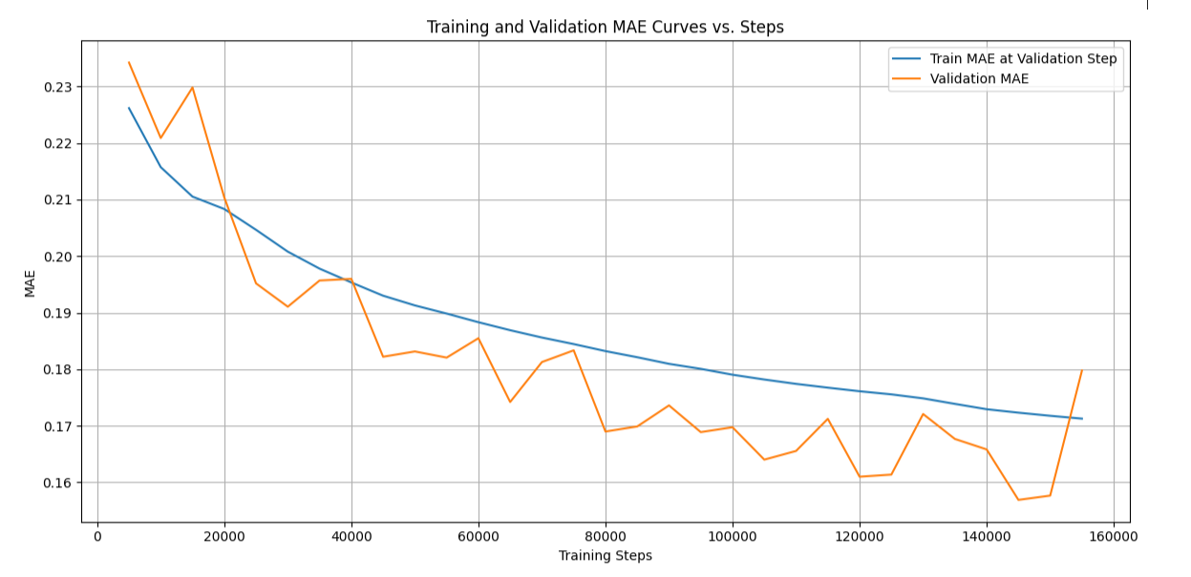
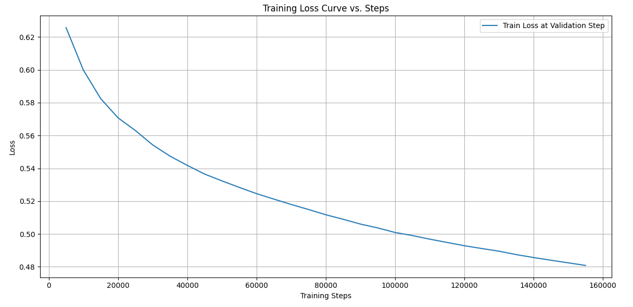
Results - Convolutional Neural Network (CNN)
Achieved the best overall performance on the test set.
Key Metrics: Test MAE = 0.1579, Test Accuracy (Win Prediction) = 0.8027, Training Time = 1h 45m.

Slide 8
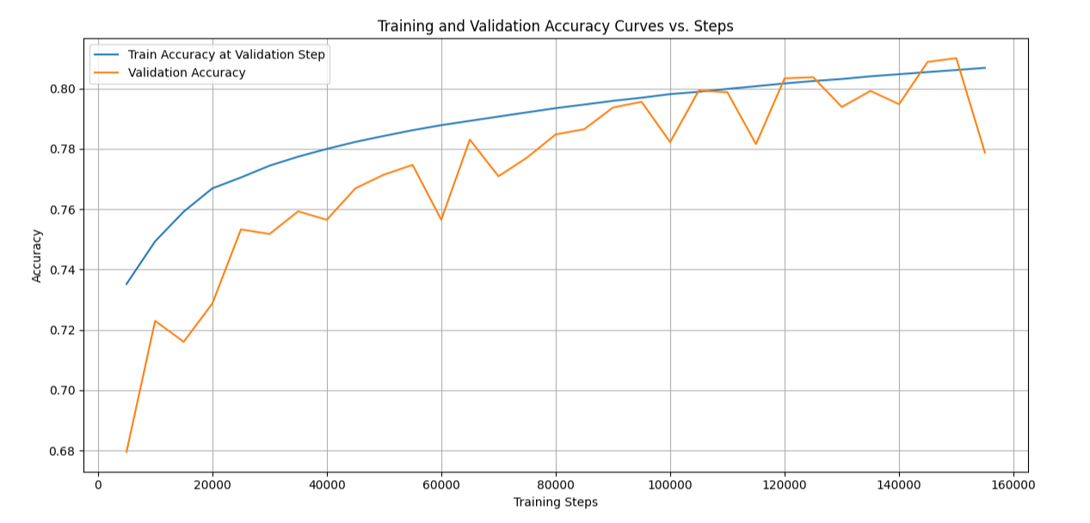

Slide 9
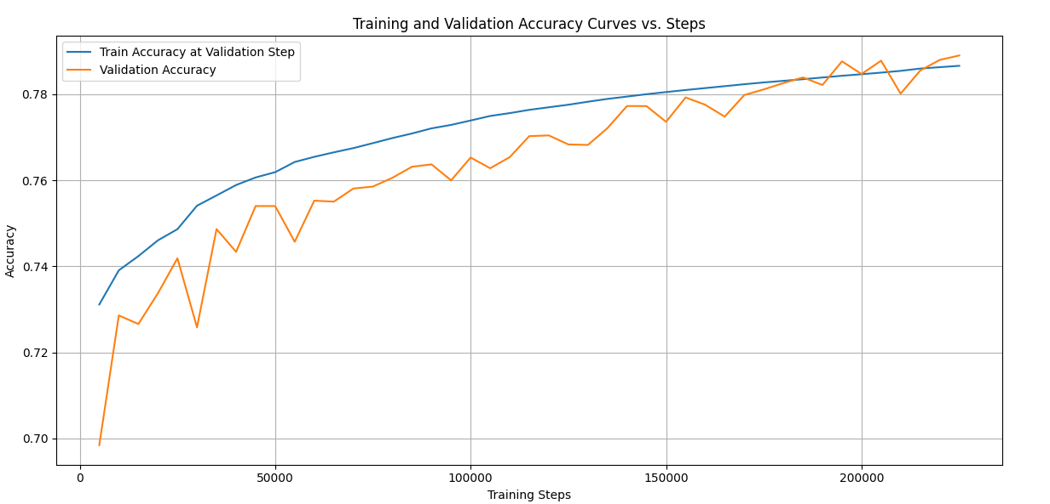
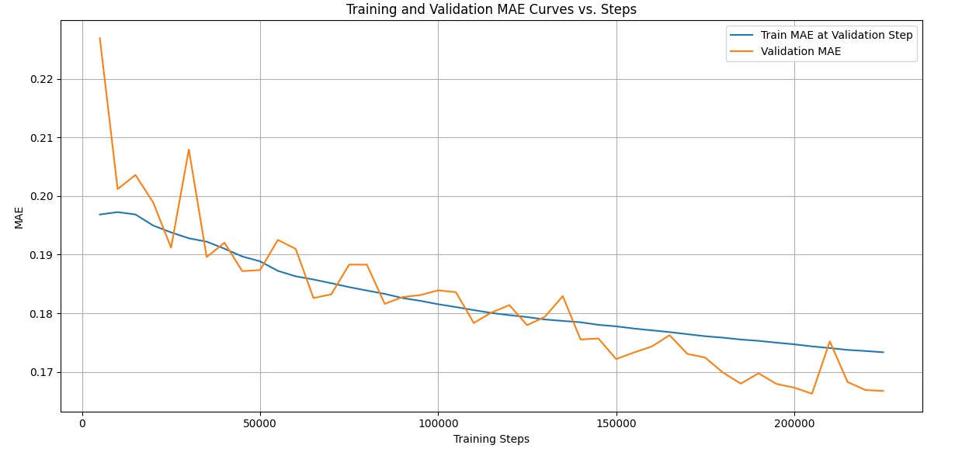
Results - Transformer
Showed competence but was slightly outperformed by the CNN. An initial baseline run (evaluation only) achieved MAE 0.1984.
Key Metrics (Final Multi-Task): Test MAE = 0.1663, Test Accuracy = 0.7892, Training Time = 2h 10m.

Slide 10
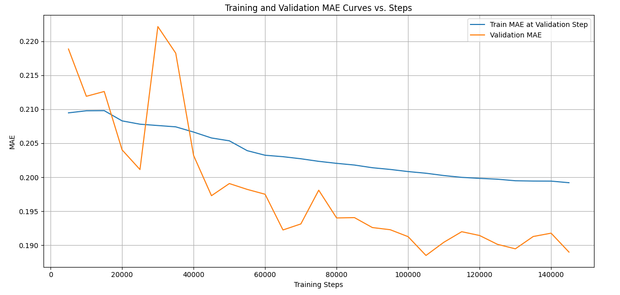
Results – Single Task Transformer

Slide 11
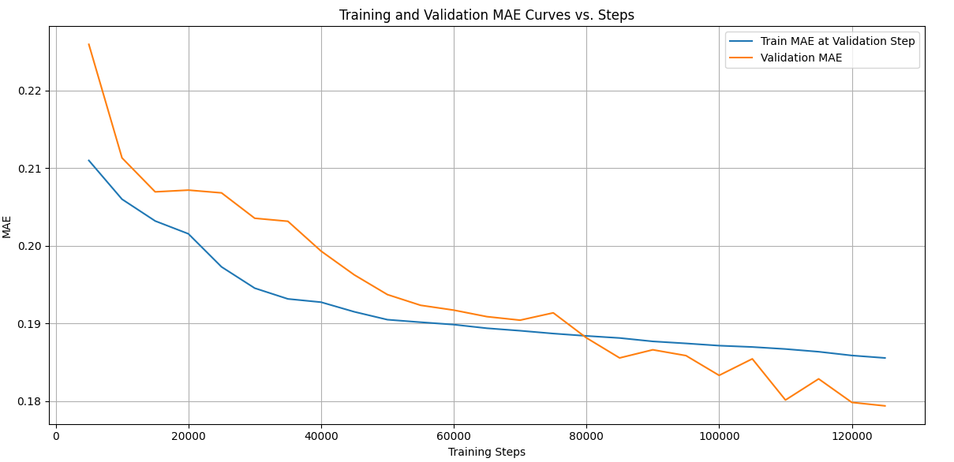
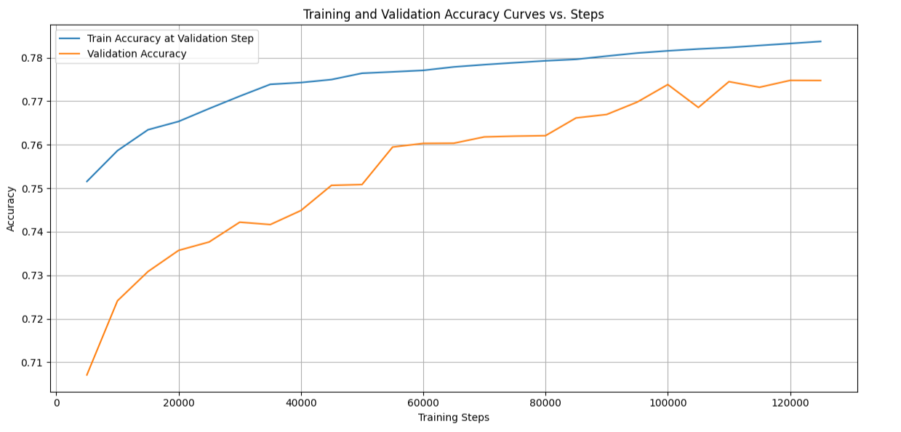
Results - MLP
MLP demonstrated competitive results, slightly behind the CNN but comparable to the Transformer. Key Metrics: Test MAE = 0.1750, Test Accuracy = 0.7825, Training Time = 1h 53m
Not quite the best, but considering that it was a relatively simple architecture with no additional features than piece information (most of which were 0’s), it is an interesting result.

Slide 12
Discussion & Limitations
All architectures can learn to approximate Stockfish evaluations and predict win probabilities, validating the supervised, multi-task approach. CNN's success highlights the value of spatial inductive bias.
Limitations included using only ~1/3 of the available data, computational resource constraints limiting model complexity/training duration, potentially suboptimal input representations (lacking move history), and information loss from clamping evaluation scores.

Slide 13
Future Work & Conclusion
Future Work: Train on the full dataset, incorporate move history/temporal context, refine target evaluation mapping, explore architectural enhancements/hybrids, and perform detailed inference efficiency analysis.
Conclusion: End-to-end deep learning, particularly CNNs, shows promise for chess evaluation approximation directly from board states, offering insights into capturing complex game heuristics.

Slide 14
Demo!

